Slide 1
NYX Control System
February 18 2015

Slide 2
X4 Control System at NSLS(Old)
ADSC GUI
Data Collection
Crystal Logic
pXSCAN
End Station
Camera
Diffractometer
Photon Delivery
Mono
Mirror
Alignment
Detector
Robot

Slide 3
Small Control group, limited resources
Looking for better control system
1) Simple, reliable, secure and user friendly
2) Central control and easy to integrate new hardware
3) Able to create your own script functions
4) Minimal development work
5) All the controls under one GUI

Slide 4
BLUICE meets all of the above and Plus
Support from SSRL
Update the new version from SSRL

Slide 5
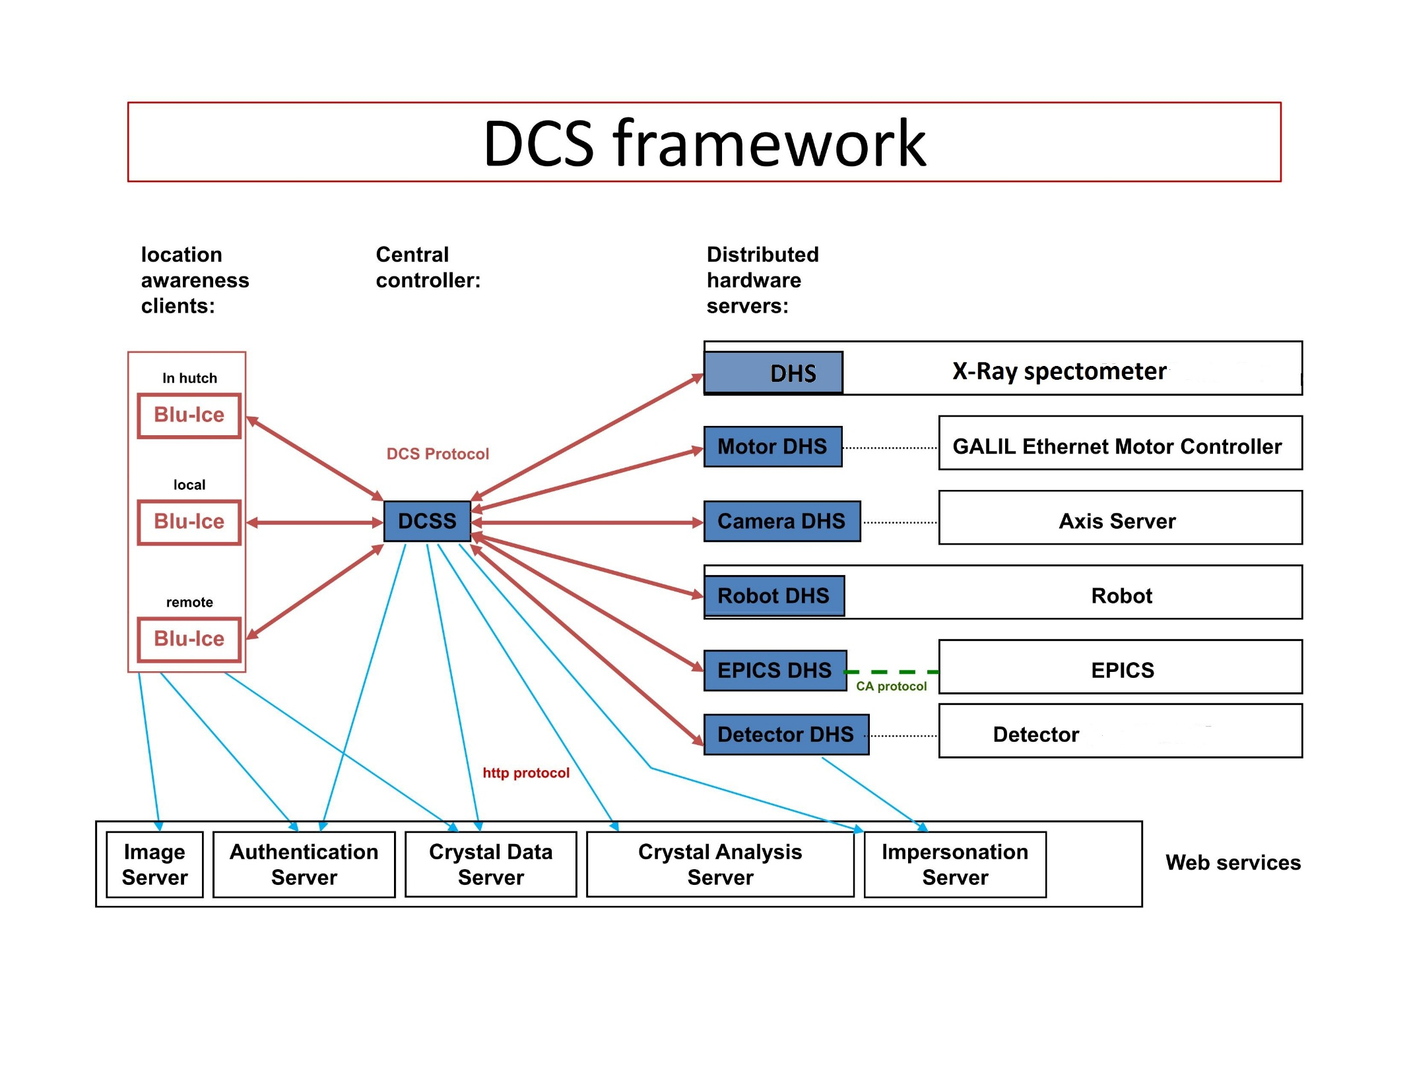

Slide 6
X4 Control System at NSLS (Upgrade)
Bluice + xPSCAN
Bluice
pXSCAN
End Station
Camera
Robot
Detector
Diffractometer
Photon Delivery
Mono
Mirror
Alignment

Slide 7
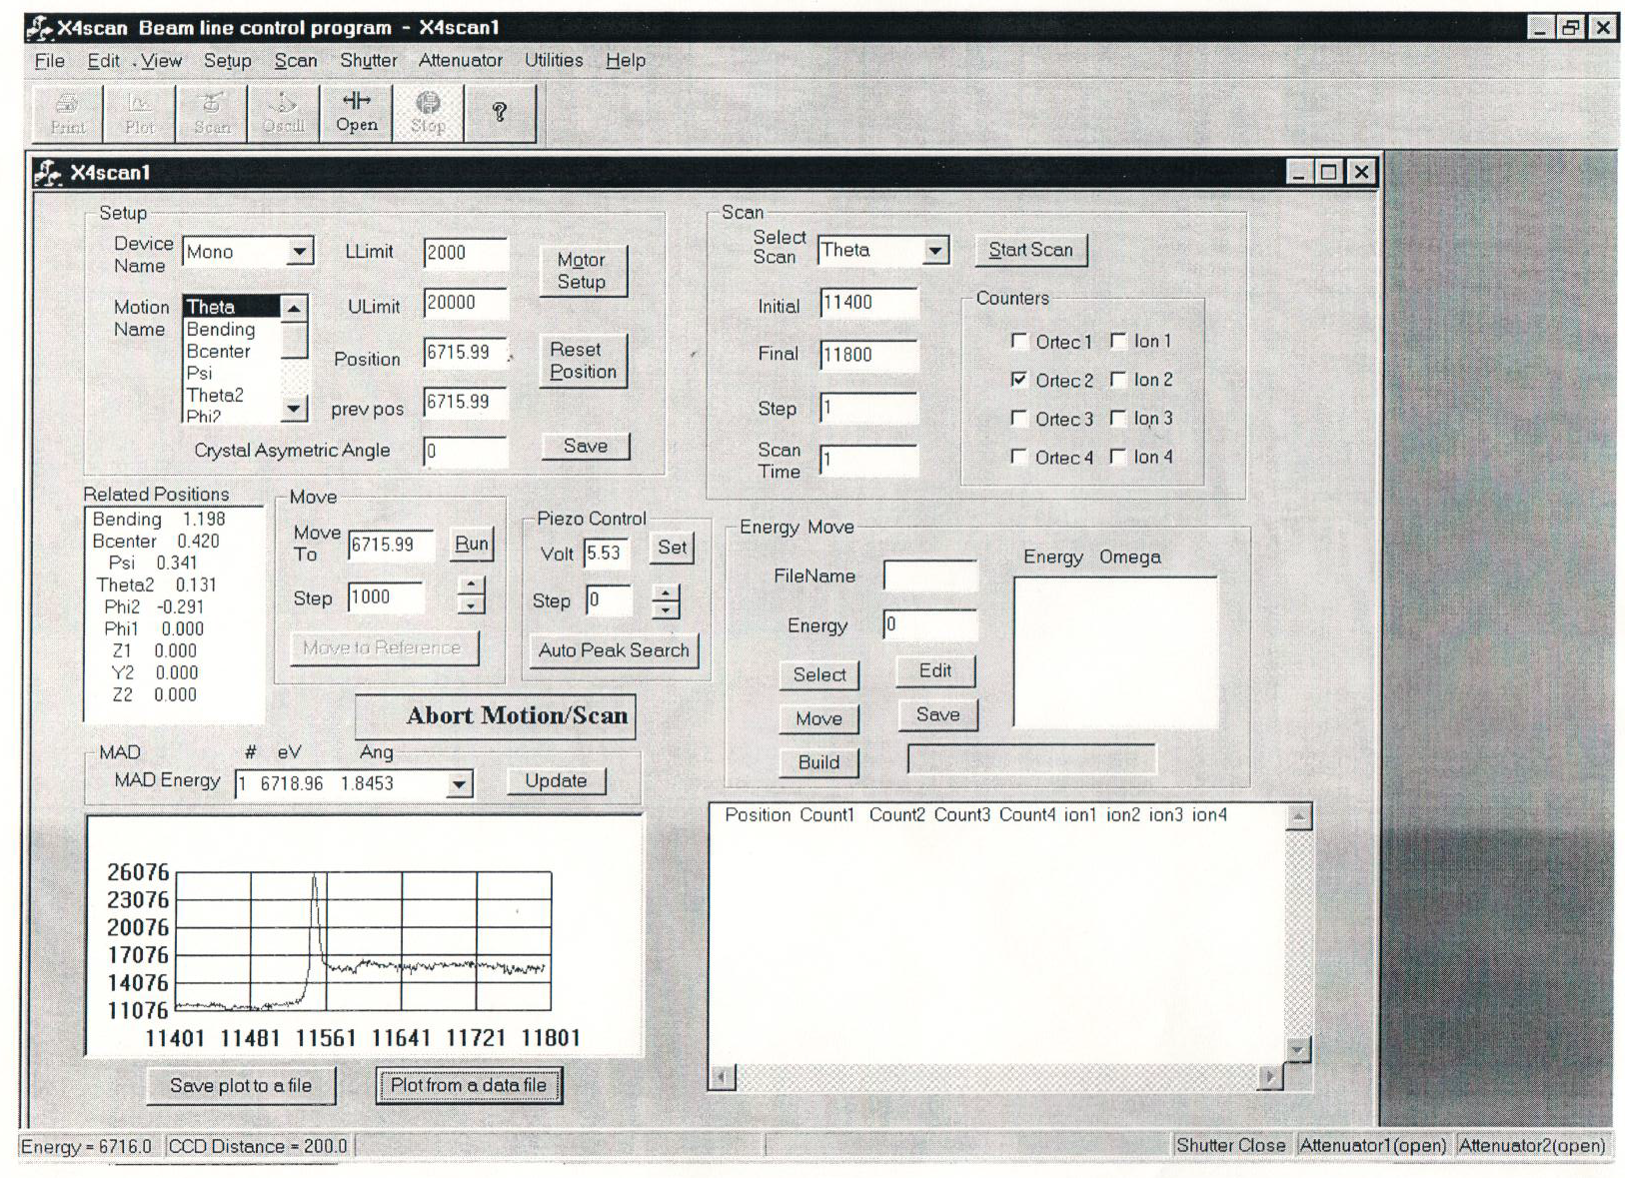

Slide 8
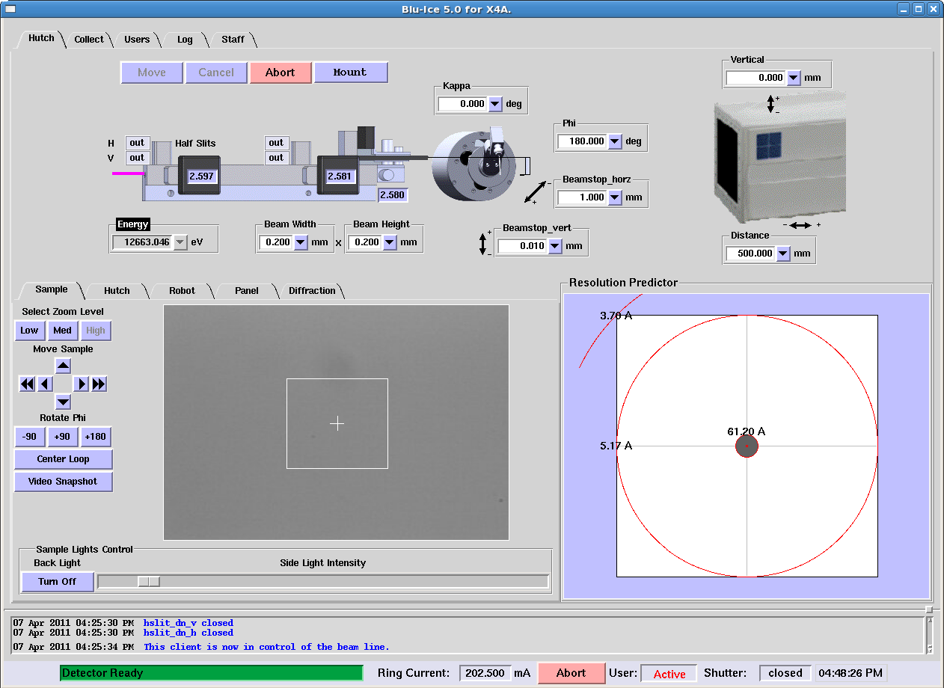

Slide 9
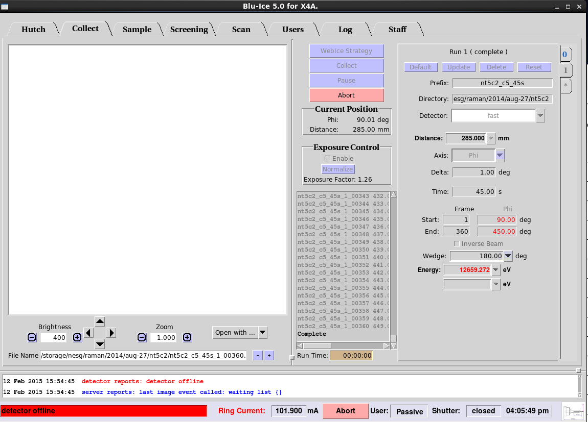

Slide 10
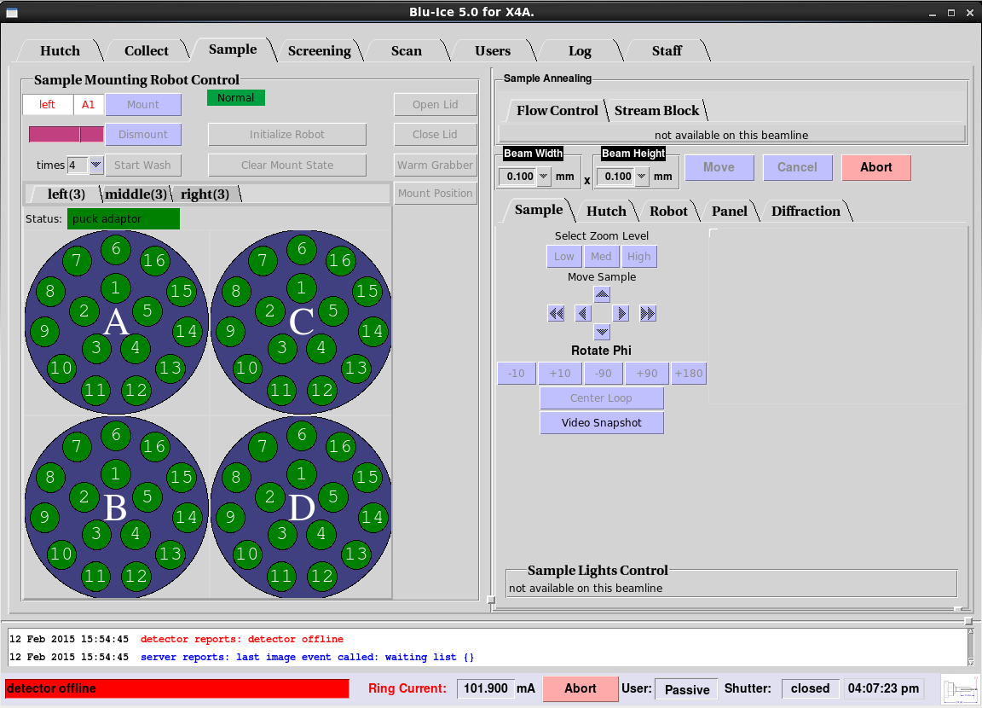

Slide 11
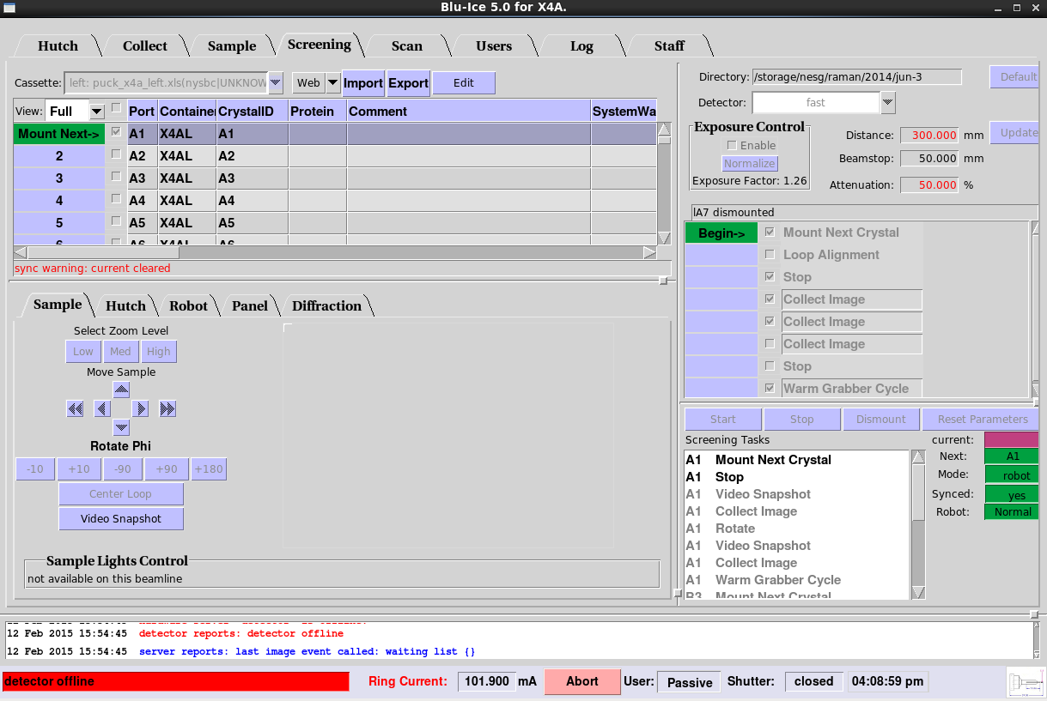

Slide 12
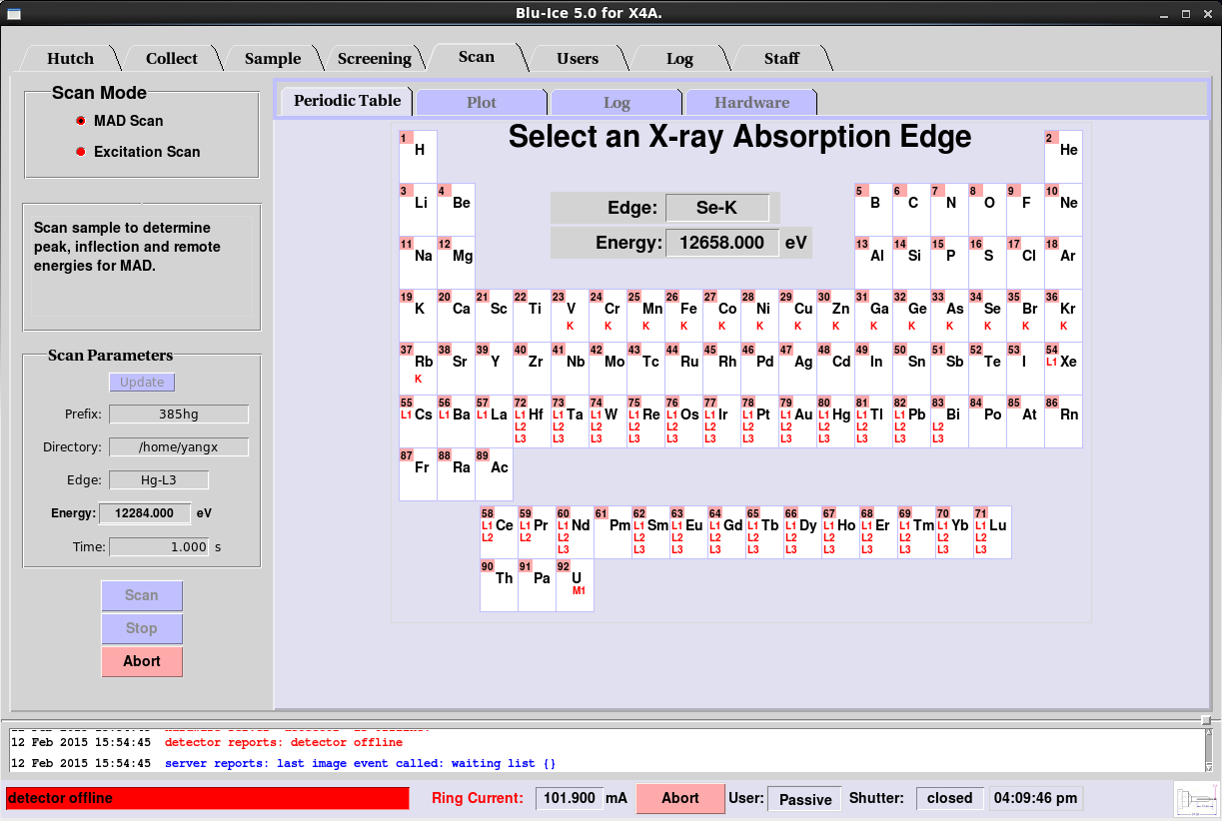

Slide 13
NYX at NSLS2 Major Components
Dual mode detector: ADSC
Diffractometer: Crystal logic
Robot system: Crystal logic
Monochrometer: Oxford FMB
Cryo Cooler: Bruker
Mirror: IRELEC
Insersion device: X25/NSLS2&NYSBC
Motion Control: Galil DMC4080/delta Tau

Slide 14
ID-19 NSLS2
Bluice Control
BLUICE GUI
DCSS
EPICS Gateway
DHS
EPICS IOC
Robot
Detector
Camera
Motors
Motors
Other devices

Slide 15
Current Status
1) Detector: Collected data with new prototype detector
2) Diffractometer: Come with Galil controller
3) Axis Camera server: Being used at X4
4) Mono & Mirror: Controlled by Galil (new)
5) Robot System: Upgraded from X4 Auto mount system
6) Insertion Device: X25

Slide 16
Summary
Least risk (transition from X4 to NYX)
Good support from SSRL
Take advantages of using other software developed with bluice
like webice, autodrug.

